Slide 1
Curses, Consequences and Coverings
Gen. 3:8-24

Slide 2
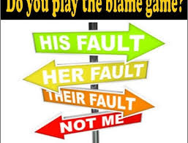
Do you Play the Blame Game?

Slide 3
Curses and Consequences
Serpent
  Most cursed of all livestock, eat dust, crawl on bellies, enmity between woman and him
Eve
  More pain in childbirth, desire contrary to her husband

Slide 4
Curses and Consequences
Adam
  Responsibility is placed on him
  Ground is cursed because of him
    Thorns and thistles will come forth
    In pain we eat of it
  Toilsome Labor

Slide 5
What About Death?
Physical – separation of the body and the soul
Spiritual – separation of the person and God
Eternal – permanent separation of God and person
Death often means separation not annihilation

Slide 6
Coverings
Covered with garments of skin
“For the life of the flesh is in the blood, and I have given it for you on the altar to make atonement for your souls, for it is the blood that makes atonement by the life” Lev. 17:11

Slide 7
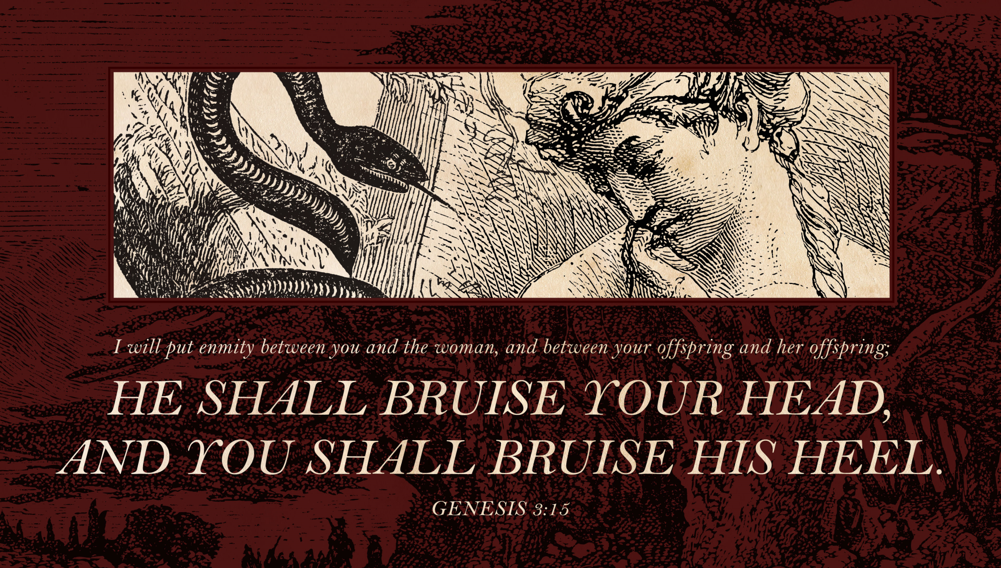
Protoevangelium

