Slide 1
God Provides Liberation
Exodus 17-14:31

Slide 2
God will lead them

Slide 3
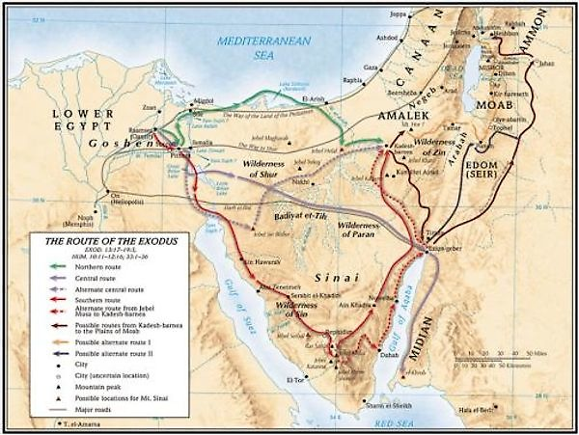

Slide 5
God will lead them
The leadership is visible, They can see it
People complain about God’s leadership
They take their eyes off God, and focus on the enemy
God will provide
He separates them from the enemy

Slide 8
God will lead them
The leadership is visible, They can see it
People complain about God’s leadership
They take their eyes off God, and focus on the enemy
God will provide
He separates them from the enemy

